Slide 1
Framework Integrated Sensor Hybrid
By Jacob champion

Slide 2
Implementation
Laser (hologram) projected pellets will be created inside a tank to represent players. Which the fish will be fooled into thinking is food by using their in built detection
Multiple cameras will be capturing the fish from different angles, which then turn it into a 3d model for implementation.

Slide 3
What possibilities exist with this technology?
Pets could act as ai enemy’s.
Bring creative worlds more life.
Instead of multilayer with family and friends what about your pet?

Slide 4
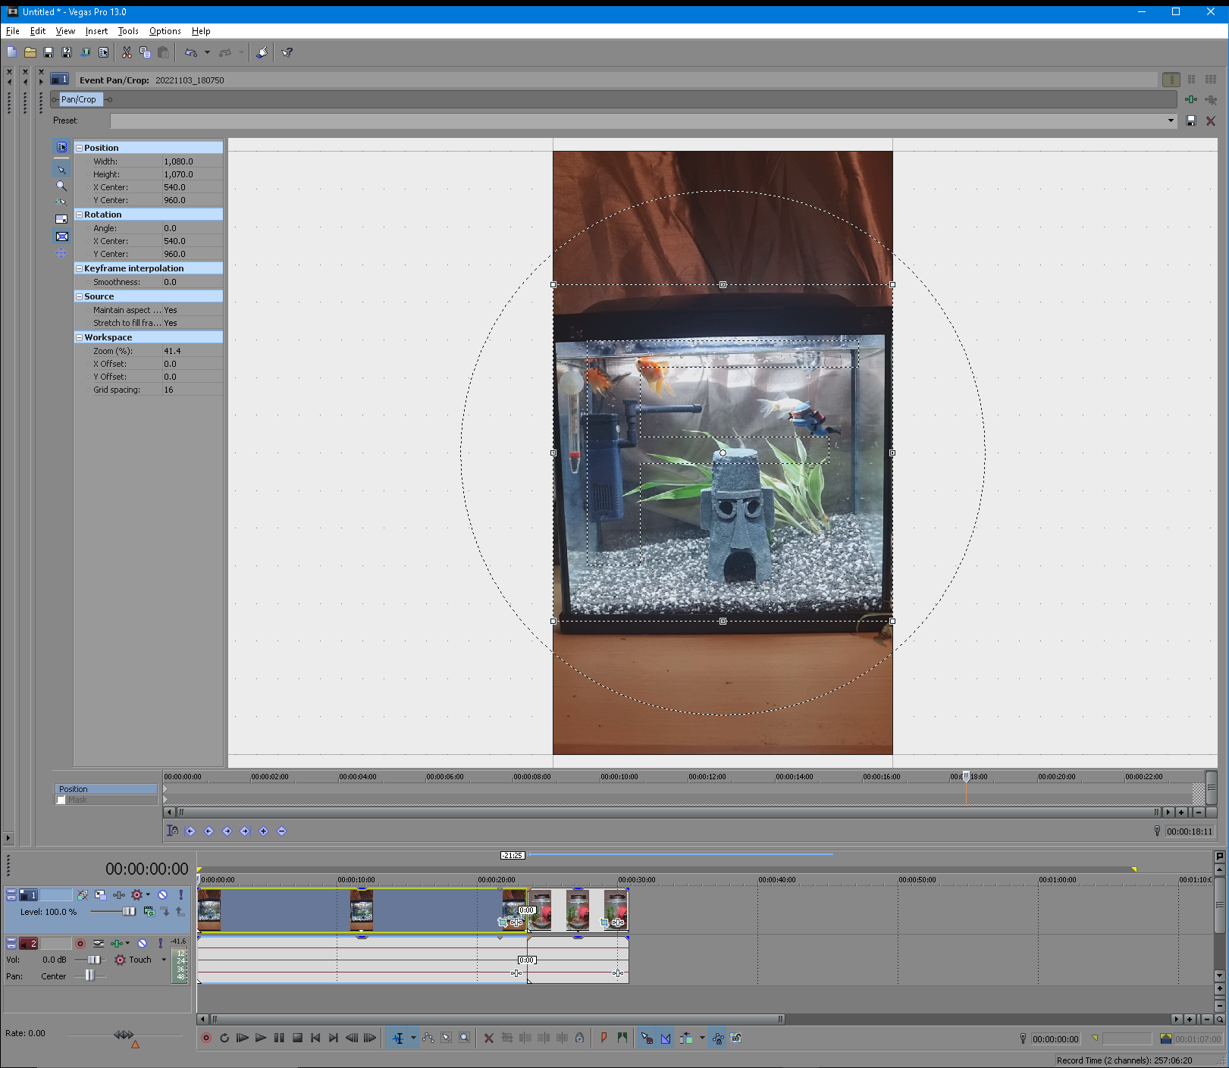
Documentation Sony Vegas
Cropping & Camera Stabilization.

Slide 5
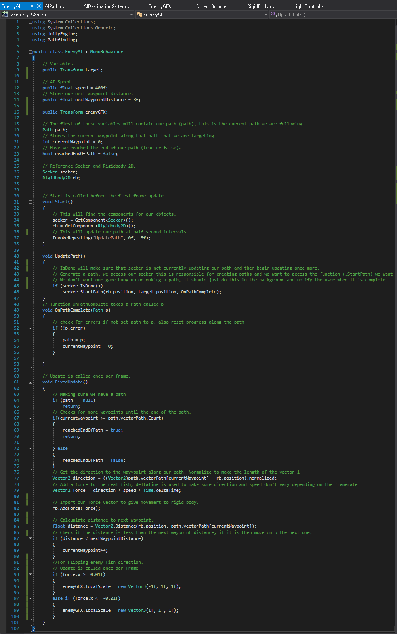
Unity Implementation
In this script, I program the real fish to chase the player fish around the tank.

Slide 6
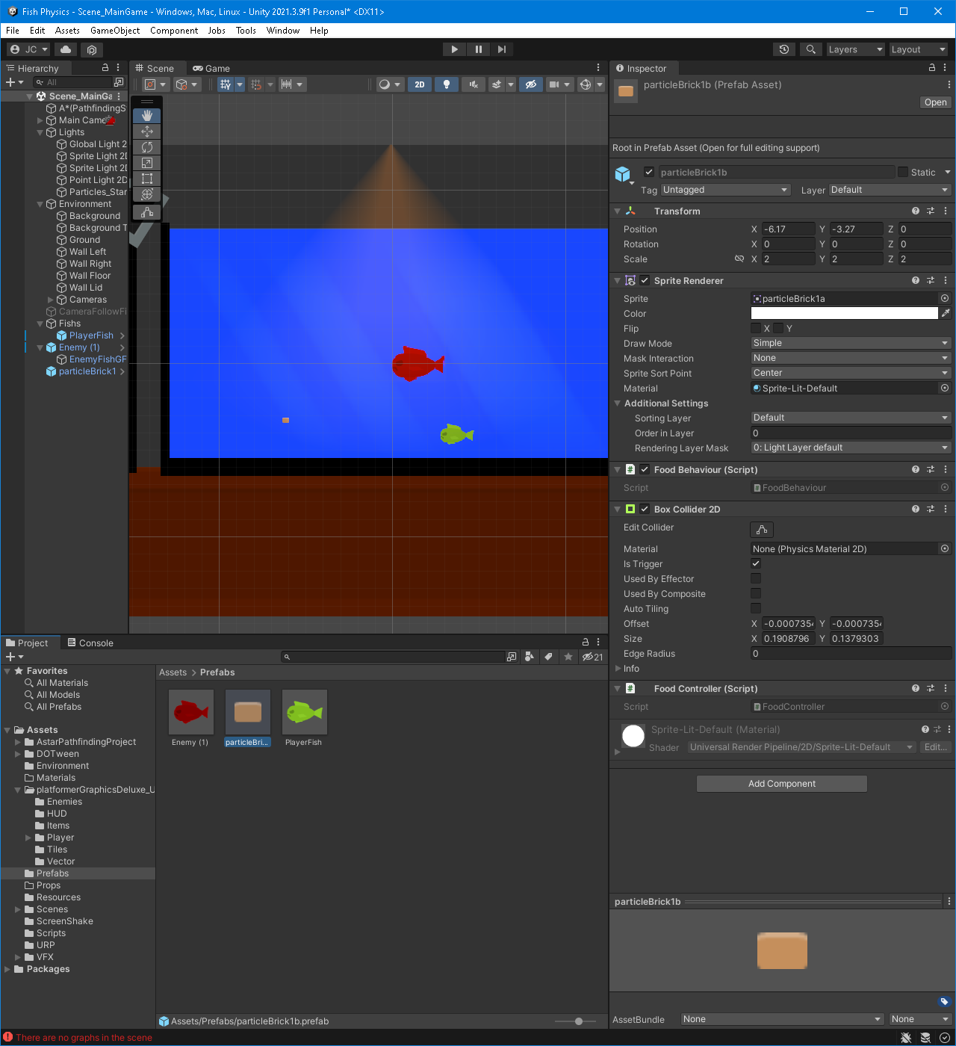
Unity - Prefabs
Creation of prefabs to save time creating the same players, enemies, or items.

